Slide 1
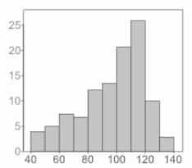
SQuAD Question Answering
Imbalance
Gagan Gopinath, Sai Raghava Mukund, Tarun Anand

Slide 2

Introduction
What is Question Answering?
Why is it important ?
Types of Question Answers
Notes:
Just like teaching or giving context and asking questions to students in order to check their understanding
machine comprehension of human language.

Slide 3
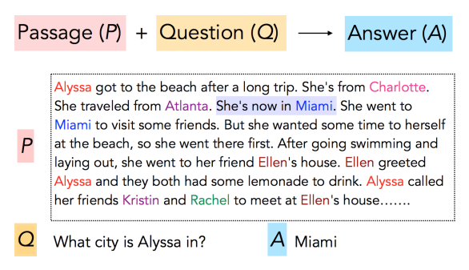
Task

Slide 4
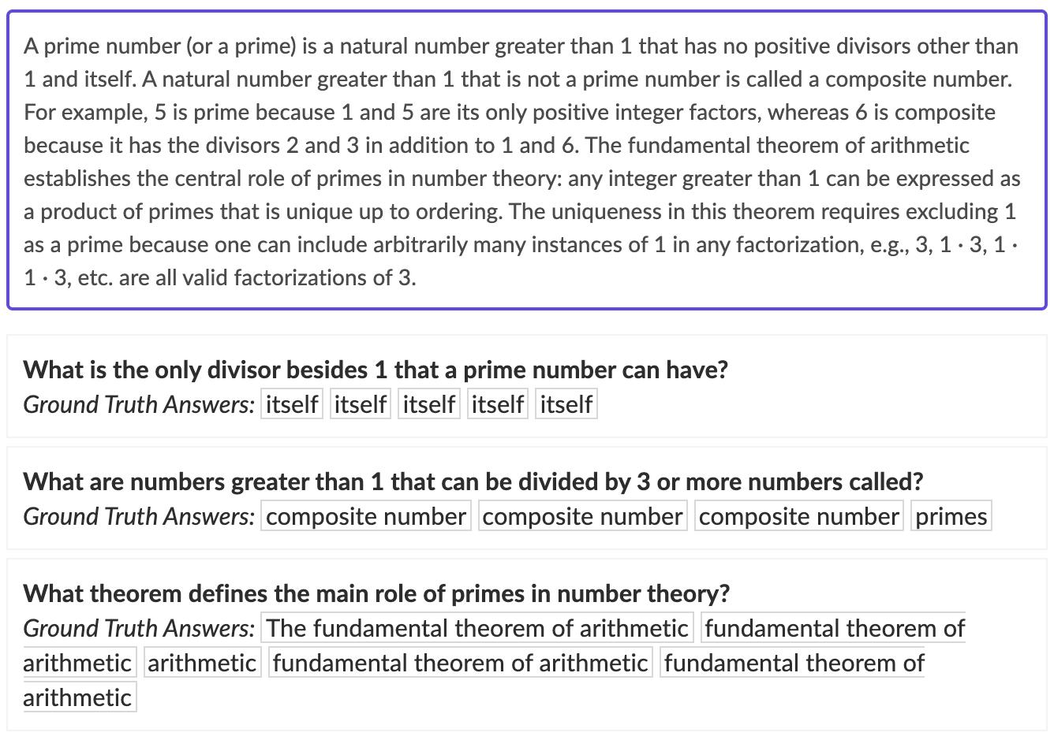
SQuAD

Slide 5
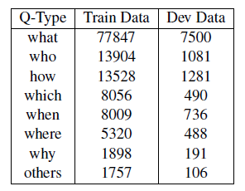
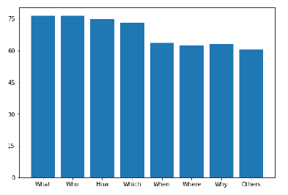
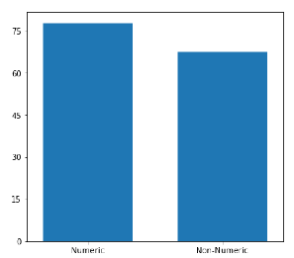
Motivation
Doesn’t work well in real-world scenarios
All questions - equally important
Data Imbalance
Question Split Up
Numeric vs Non-Numeric F1 scores
Corresponding F1 scores

Slide 6
Related Work

Slide 7
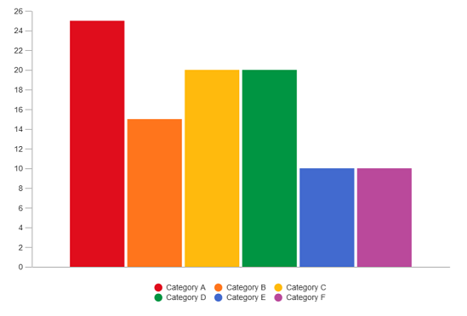
Approach
Undersampling
Question generation
CoQA Dataset Augmentation

Slide 8
Approach
Passage
Undersampling
Question generation
CoQA Dataset Augmentation
Q/A Generator
Question
Answer
Filter
Under-represented Question-Answer Pairs

Slide 9
Approach
Undersampling
Question generation
CoQA Dataset Augmentation
CoQA Dataset
SQuAD Dataset

Slide 10
Results
Graphs and accuracies

